Slide 1
Applied Statistics, Probability theory and mathematical statistics
István Fazekas, Attila Barta, Sándor Pecsora
Discrete random variables,
Parameters of discrete random variables
”This work was supported by the construction EFOP-3.4.3-16-2016-00021. The project was supported by the European Union, co-financed by the European Social Fund.”

Slide 2

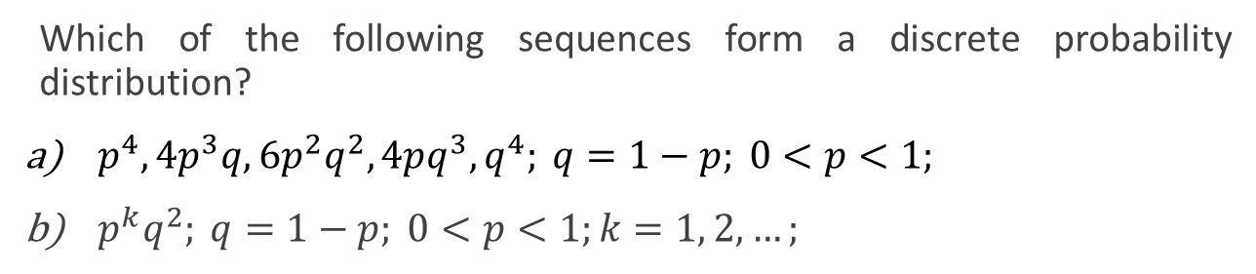
Exercise 7.1
Which of the following sequences form a discrete probability distribution?
$p^{4}, 4p^{3}q, 6p^{2}q^{2}, 4pq^{3}, q^{4}; q=1−p; 0<p<1;$
$p^{k}q^{2}; q=1−p; 0<p<1;k=1, 2, …;$
$${a) \left(p+q\right)}^{4}={\left(p+\left(1−p\right)\right)}^{4}=1$$
$$b) \sum_{k=1}^{∞}{p^{k}q^{2}}={\left(1−p\right)}^{2}\sum_{k=1}^{∞}{p^{k}}={\left(1−p\right)}^{2}p\sum_{k=0}^{∞}{p^{k}}={\left(1−p\right)}^{2}p\frac{1}{1−p}=\left(1−p\right)p≠1$$

Slide 3
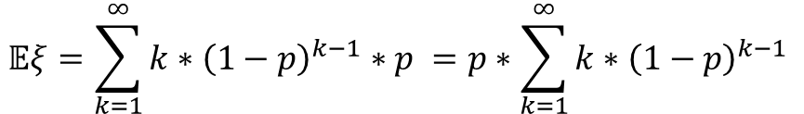
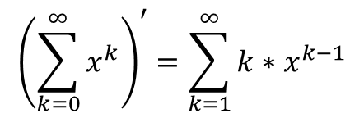
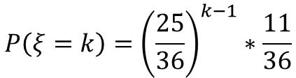
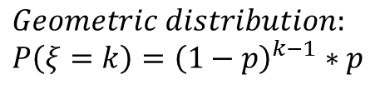
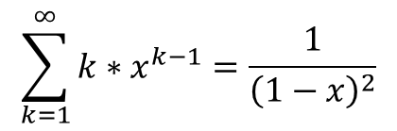
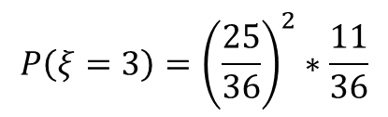

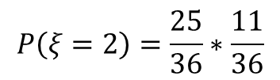
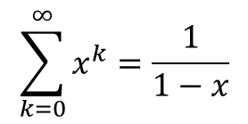
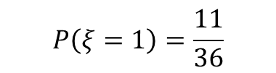
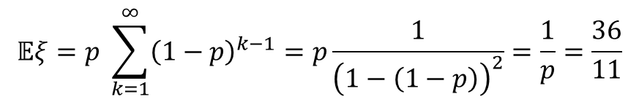
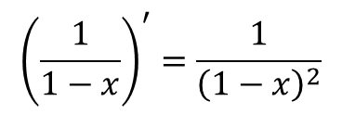
Exercise 8.1 (M1)
Two dice are rolled till the first six appears on one of them. What is the mean number of rolls required, inclusive the last one?
$$ξ−number of rolls till the first 6 appeares$$
$$P\left(ξ=1\right)=\frac{11}{36}$$
$$\sum_{k=0}^{∞}{x^{k}}=\frac{1}{1−x}$$
$$0<x<1$$
$$P\left(ξ=2\right)=\frac{25}{36}∗\frac{11}{36}$$
$${\left(\sum_{k=0}^{∞}{x^{k}}\right)}^{′}=\sum_{k=1}^{∞}{{k∗x}^{k−1}}$$
$${\left(\frac{1}{1−x}\right)}^{′}=\frac{1}{{\left(1−x\right)}^{2}}$$
$$P\left(ξ=3\right)={\left(\frac{25}{36}\right)}^{2}∗\frac{11}{36}$$
$$\sum_{k=1}^{∞}{{k∗x}^{k−1}}=\frac{1}{{\left(1−x\right)}^{2}}$$
$$P\left(ξ=k\right)={\left(\frac{25}{36}\right)}^{k−1}∗\frac{11}{36}$$
$$𝔼ξ=p \sum_{k=1}^{∞}{{\left(1−p\right)}^{k−1}}=p\frac{1}{{\left(1−\left(1−p\right)\right)}^{2}}=\frac{1}{p}=\frac{36}{11}$$
$$Geometric distribution: \\ P\left(ξ=k\right)={\left(1−p\right)}^{k−1}∗p$$
$$𝔼ξ=\sum_{k=1}^{∞}{k∗{\left(1−p\right)}^{k−1}∗p }=p∗\sum_{k=1}^{∞}{k∗{\left(1−p\right)}^{k−1} }$$

Slide 4
Exercise 8.1 (M1) MATLAB solution
n = 10^7;
s = 0;
for i=1:n
while true
s=s+1;
if rand()<1/6 | rand()<1/6
break;
end
end
end
s/n
36/11

Slide 5



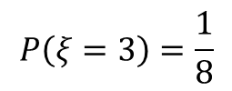
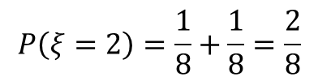
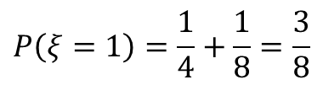
Exercise 8.4 (M2)
A coin is tossed. If the result is a head, it is tossed two more times, otherwise it is tossed one more time. What is the mean number of heads obtained?
$$ξ−number of heads$$
$$P\left(ξ=0\right)=\frac{1}{4}$$
$$𝔼ξ=0∗\frac{1}{4}+1∗\frac{3}{8}+2∗\frac{2}{8}+3∗\frac{1}{8}=\frac{5}{4}$$
$$P\left(ξ=1\right)=\frac{1}{4}+\frac{1}{8}=\frac{3}{8}$$
$$P\left(ξ=2\right)=\frac{1}{8}+\frac{1}{8}=\frac{2}{8}$$
$$P\left(ξ=3\right)=\frac{1}{8}$$

Slide 6
Exercise 8.4 (M2) MATLAB solution
n = 10^6;
s = 0;
for i=1:n
if rand()<1/2
s=s+1;
if rand()<1/2
s=s+1;
end
if rand()<1/2
s=s+1;
end
else
if rand()<1/2
s=s+1;
end
end
end
s/n
5/4

Slide 7

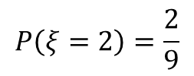
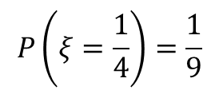


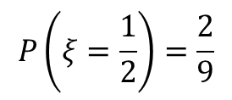
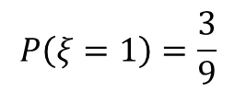

Exercise 8.7 (M3)
The nominal value of a share is one golden galleon. In a year the value either can doubled, or halved or remain the same - each of the events has the same probability. On the next year the same happens, independently of the events of the previous year. Find the distribution of the value of the share after two years. What is the mean and the variance of the value?
$$P\left(ξ=4\right)=\frac{1}{9}$$
$$𝔼ξ=\frac{49}{36}$$
$$P\left(ξ=2\right)=\frac{2}{9}$$
$$P\left(ξ=1\right)=\frac{3}{9}$$
$$𝔼ξ^{2}=16∗\frac{1}{9}+4∗\frac{2}{9}+1∗\frac{3}{9}+\frac{1}{4}∗\frac{2}{9}+\frac{1}{16}∗\frac{1}{9}=\frac{49}{16}$$
$$P\left(ξ=\frac{1}{2}\right)=\frac{2}{9}$$
$$𝔻ξ^{2}=𝔼ξ^{2}−{\left(𝔼ξ\right)}^{2}=\frac{98}{81}$$
$$P\left(ξ=\frac{1}{4}\right)=\frac{1}{9}$$

Slide 8
Exercise 8.7 (M3) MATLAB solution
n = 10^7;
x = 0;
xs = 0;
for i=1:n
g = 1;
for j=1:2
r = rand();
if r<1/3
g = g*2;
elseif r>2/3
g = g/2;
end
end
x = x+g;
xs = xs+g^2;
end
x_mean = x/n
x_var = xs/n - x_mean^2

Slide 9
Literature
Ágnes Baran: Mathematics for engineers 1. (Laboratory slides)
Sándor Baran: Probability theory and statistics
Fazekas István: Valószínűségszámítás, Debreceni Egyetemi Kiadó, 2009
Fazekas István: Bevezetés a matematikai statisztikába, Debreceni Egyetemi Kiadó, 2009
Matlab examples: https://www.mathworks.com/help/examples.html

